Slide 1

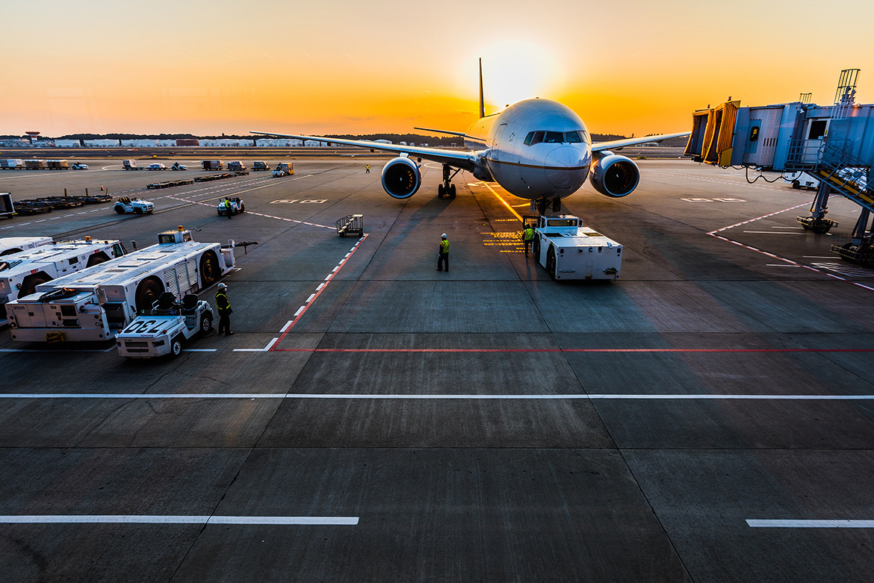
DATA AND BUSINESS ANALYTICS COURSE
Simulation Model for Mobile Cleaning Teams at Changi Airside to Aid Manpower Optimization
Team 13
FINAL REPORT | DECEMBER 2020

Slide 2
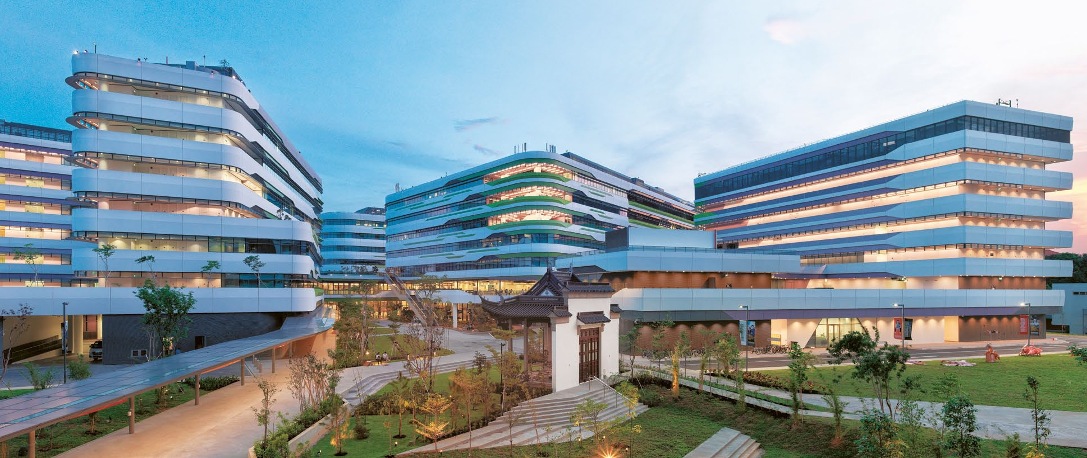


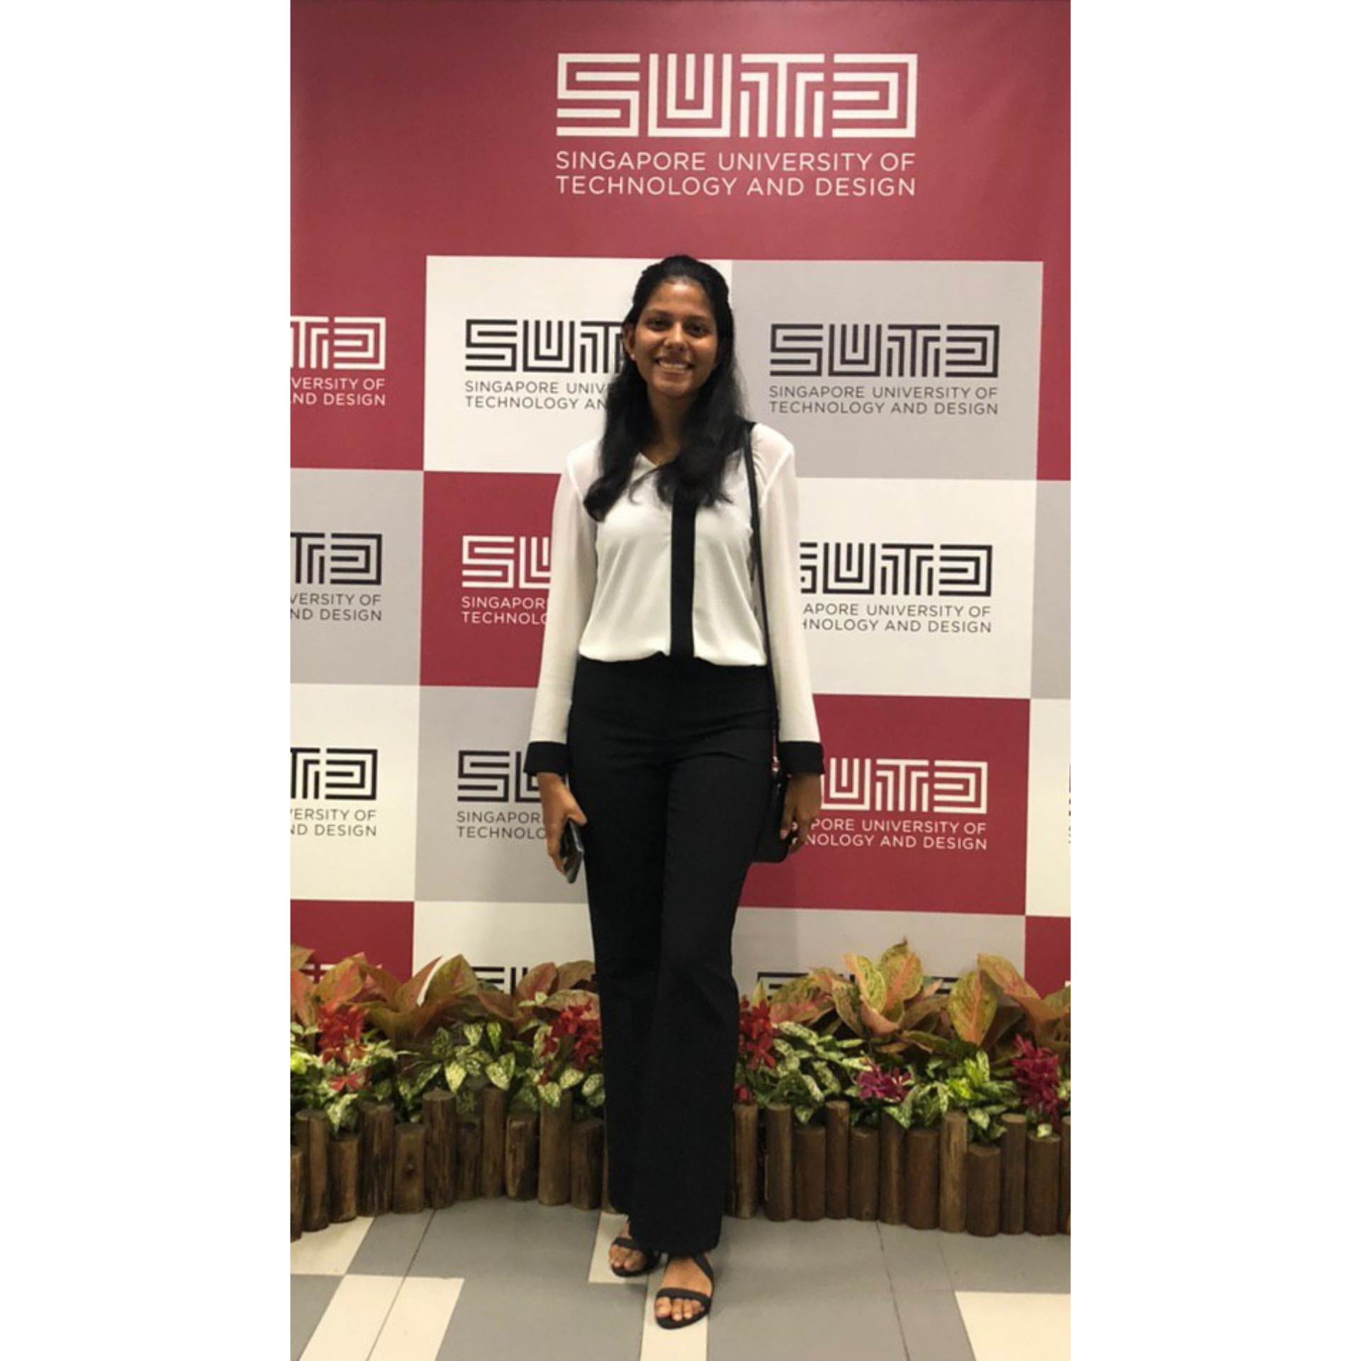



The Team
01
ENGINEERING MANAGEMENT & SYSTEM PLANNING
EMILY LIM
DAMIEN HEW
CHARINI JINADASA
RICHIE WONG
LEADER
LIAISON
REPORT COORDINATOR
MANAGER
LIU MENGLU
SENIOR ASSOCIATE
LIM TING YIN
ASSISTANT MANAGER
FRANCISCO BENITA
SUTD ADVISOR
HAZWAN HAFIZ
SAMUEL SIM
SCRIBE
SCRIBE

Slide 3
The Team
01
Changi Airport Group (CAG) is the manager of Singapore Changi Airport,
a leading air hub in Asia.
CAG performs the key functions
of airport operations, air hub development, retail and commercial
activities, infrastructure development and airport emergency services.1
1: https://www.linkedin.com/company/changiairportgroup/

Slide 4
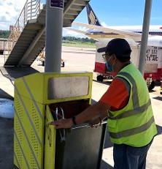

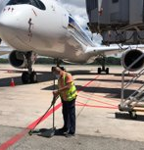
02
Problem Statement
A gradual ramp up of flights is expected as COVID restrictions are slowly being lifted.
There is a need to create a model to optimize the amount of manpower resources needed to :
1. Respond to and clear the FOD (Foreign object debris) bins or smart bins at the airside.
2. Perform sweeping and litter picking at the aircraft stands and airside roadways.
Phase 1 : Assess the current allocation of cleaning teams per shift to evaluate whether it is optimal.
Phase 2 : Optimize the number of teams required per shift by considering the new implementation of smart bins.
FINAL REPORT | DECEMBER 2020

Slide 5

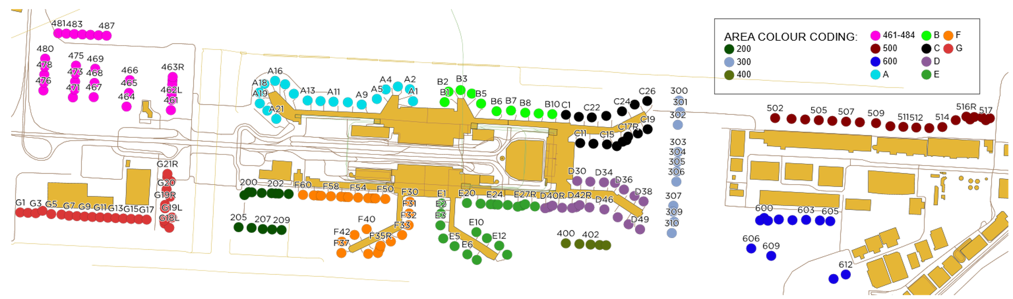
03
Preprocessing of Data
Changi Aerodrome Map: Plotted in QGIS, the different sectors (color coded) given the geographic coordinates.
Calculate the linear distance between each stand (bin) represented by the dots on the map below using QGis Distance Matrix function
FINAL REPORT | DECEMBER 2020

Slide 6
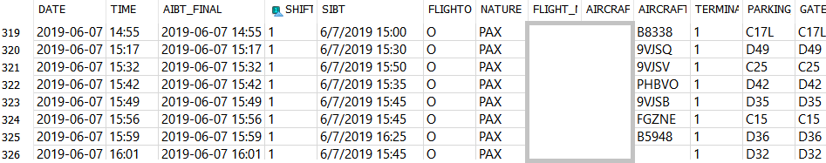
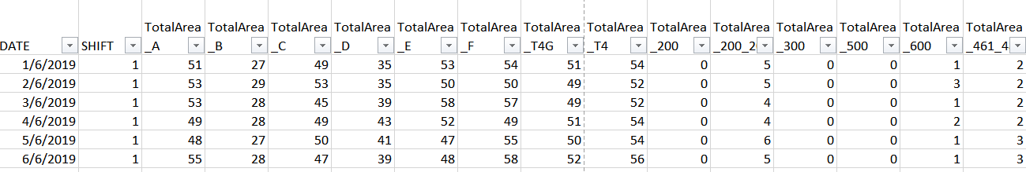
03
Preprocessing of Data
Flight Volume Data: Sorting and cleaning up of flight volume data using SQLite and Excel.
i) Flight Volume Data provided by client
ii) Number of flights for each area allocation per day
FINAL REPORT | DECEMBER 2020

Slide 7

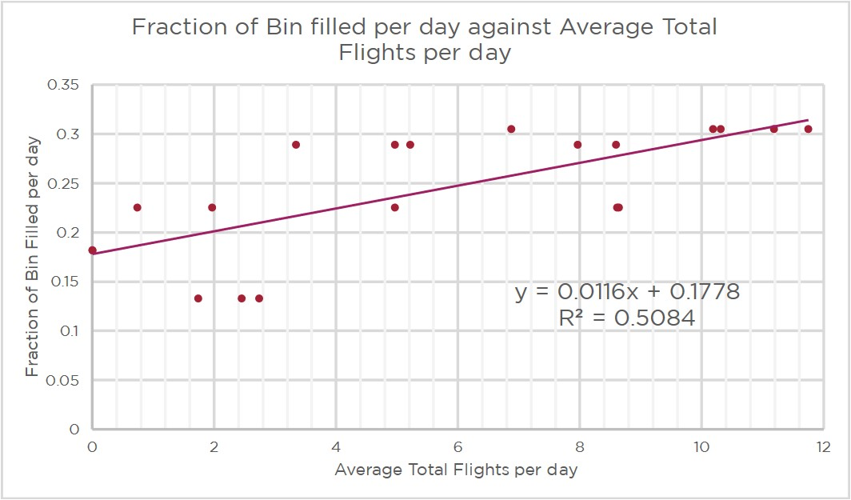
04
Regression Modelling
Smart Bin Trial Data: Finding the best relationship between average total flights per day and fraction of bin filled given smart bin trial data
Results: Linear Model is the best fit based on R² value and randomly distributed residuals
FINAL REPORT | DECEMBER 2020
Notes:
Presenter emphasize how

Slide 8

05
Optimization Model
1st Phase:
Without smart bins to track the rate of bins filling up.
2nd Phase:
Adding in of smart bins, which allow us to track the rate of bins filling up and using our regression model to predict the rate of bins filling up based on flight volume.
Tool Used:
Excel, GRG Nonlinear, Data Solver
FINAL REPORT | DECEMBER 2020

Slide 9


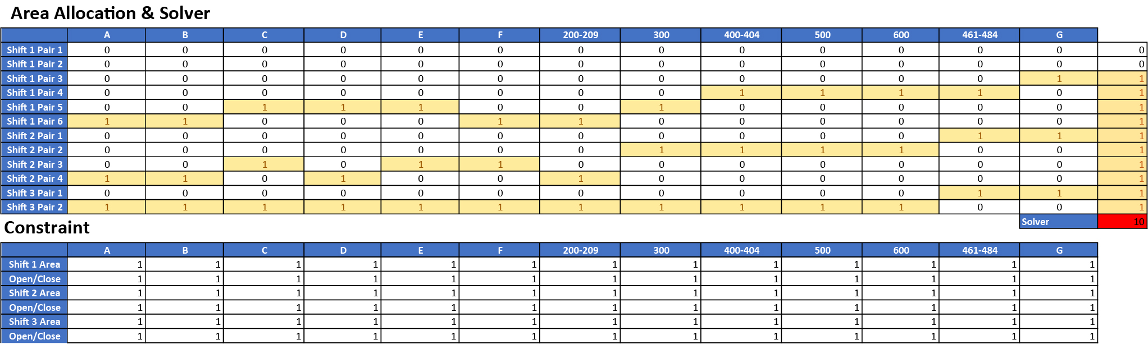
05
Optimization Model
Objective Function:
Minimize the number of Teams for each shift such that the excess time left of their working hours per pair is minimum
Current Allocation of Teams (in pairs):
Shift 1 (8am to 5pm): 6 Teams
Shift 2 (5pm to 11pm): 4 Teams
Shift 3 (11pm to 8am): 2 Teams
Decision Variable:
1 represents the area is allocated to the team
0 represents the area is not allocated to the team
FINAL REPORT | DECEMBER 2020

Slide 10
05
Optimization Model
Constraints:
Each area checked once per round of check by each shift, which also depends if the area is initially opened (1) or closed (0).
FINAL REPORT | DECEMBER 2020

Slide 11
05
Optimization Model
Input Parameters:
Adjustable Parameters (for client):
Number of stands or bins opened
Monthly Flight Volume
Number of rounds (checks) by each team during each shift
Checking and Clearing Timings per bin
Total (Includes non-working) Hours per shift
Working Hours per shift
Fixed Parameters:
Travel time between each bin
Fraction of Bin Filled per day for each area (achieved using the regression model embedded in the Excel Sheet)
FINAL REPORT | DECEMBER 2020

Slide 12
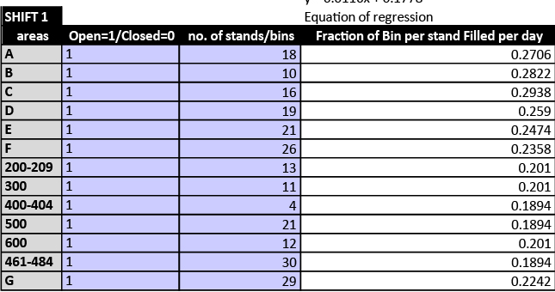
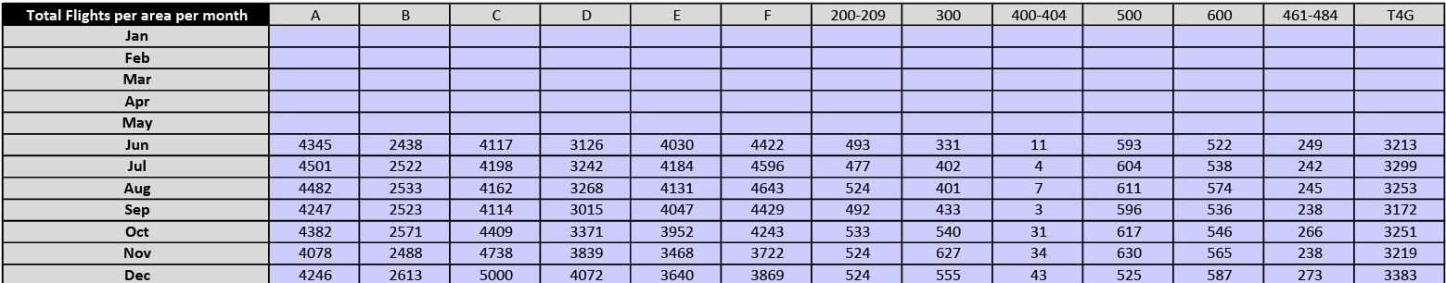
05
Optimization Model
Number of stands or bins opened, for Shift 1
Monthly Flight Volume (e.g. November 2019)
FINAL REPORT | DECEMBER 2020

Slide 13
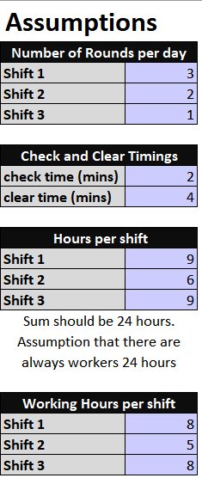
05
Optimization Model
Number of rounds (checks) by each team during each shift
Checking and Clearing Timings per bin
Total (Includes non-working) Hours per shift
Working Hours per shift
FINAL REPORT | DECEMBER 2020

Slide 14
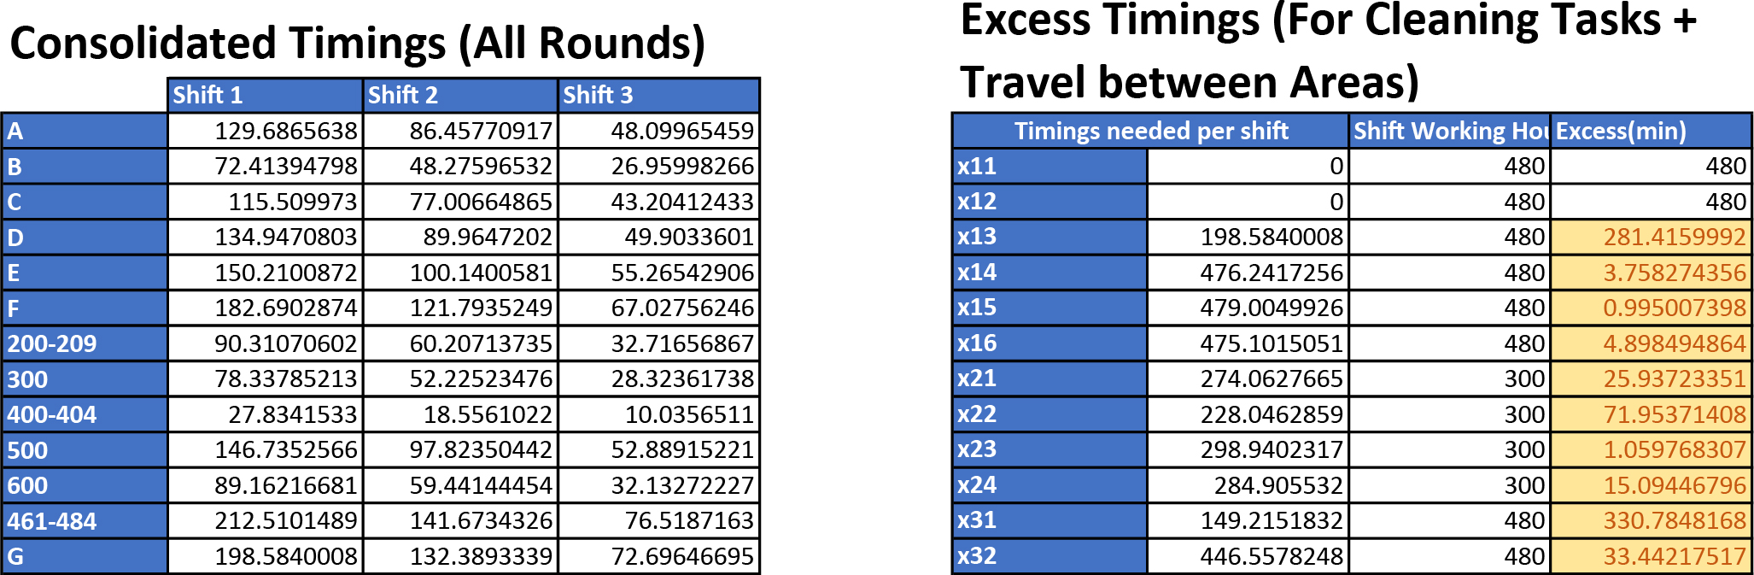
05
Optimization Model
From the parameters, for a round of check we sum up
Clearing time per bin based on the fullness of the bin
Checking time per bin
Travel time between each bin for allocated area.
Then we calculate for timings for all rounds instead of 1, resulting in Consolidated Timings, together with the area allocation in the decision variable will affect the timing needed per shift for each pair of worker, and the excess timings.
FINAL REPORT | DECEMBER 2020

Slide 15

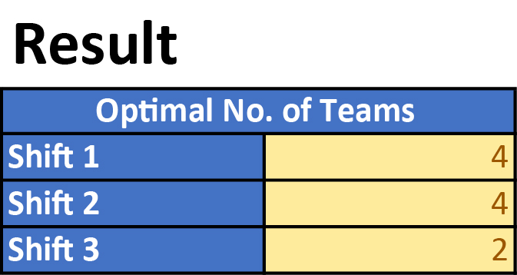
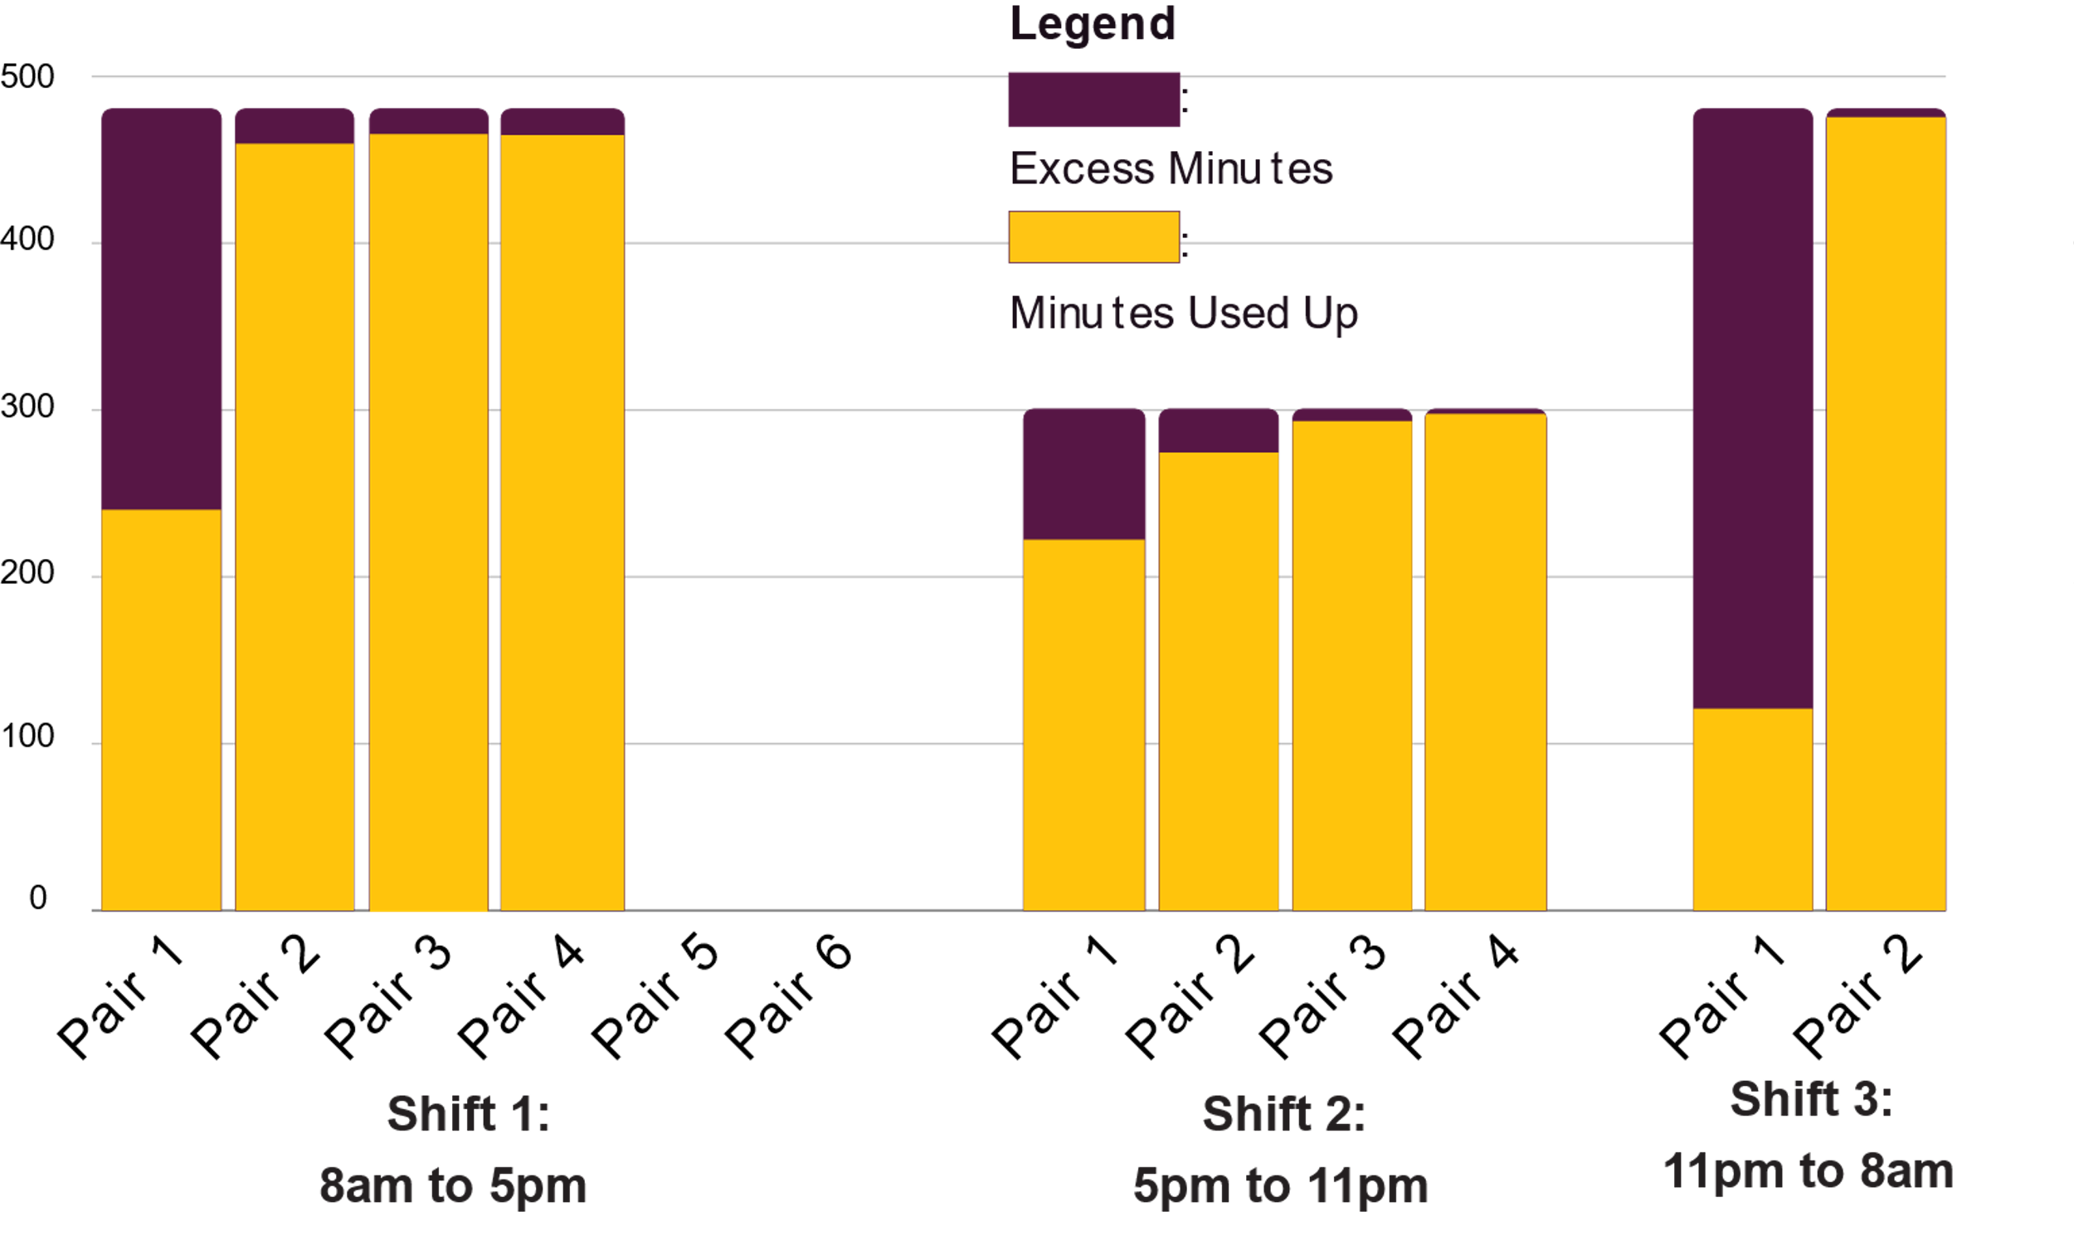
06
Results of Model
Optimal, Minimum Number of Teams (For November 2019):
Analysis:
Client can indeed reduce the number of workers needed based on the flight volume data for the month.
If there is forecasted data for the coming months flight volume, the number of workers needed can be decided prior to each month.
Minimizes manpower costs for the company.
FINAL REPORT | DECEMBER 2020

Slide 16

07
Limitations of Model
1. Limited number of points for regression modelling of the average flight volume per day and the fraction of bin filled per day. Only 20 data points were available for modelling.
2. QGIS Distance Matrix: Calculates Linear Distances. However, the travelling path between stands may not be linear which would differ the travelling time calculated.
3. Does not take into the account that if the flight volume is very high, more than the current number of teams is required.
FINAL REPORT | DECEMBER 2020

